Slide 1
Writing Your Own Functions
So far, we've mostly been using functions that other programmers have already written for us, like turn_left(), and print().
But you can also create functions of your own. A function is a set of repeatable code, a set of instructions that you can call upon again and again in your programs. For example, imagine you're coding a board game. You might write a function that "rolled the dice" since that's an action that will need to happen again and again.
Functions make your program more organized and allows you to reuse code easily.
Defining A Function
To create your own function, you must define it. Function definitions begin with the keyword def followed by the function name, parentheses (), and a colon :.
The code that is indented afterwards is the function body. This is the code that will run when you use your function. Defining a function won't run it, though. When you use your function later in code, that's calling the function.
Let's look at the basic syntax to start.
def function_name():
statement1
statement2

Slide 2
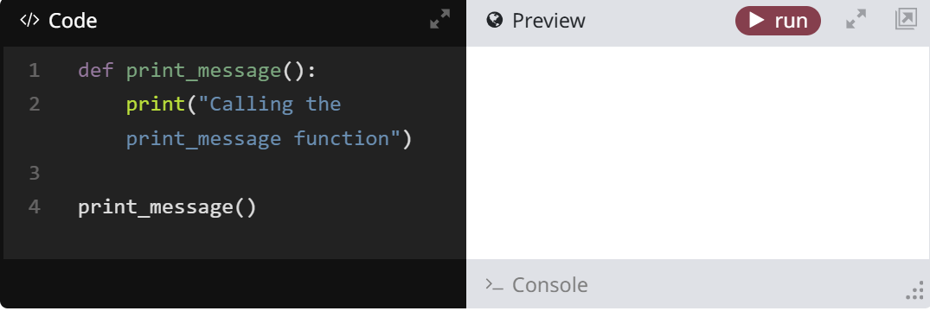
Here, we've defined a function called function_name(). statement1 and statement2 are in the body of the function.
A Simple Function
Let's define a real function we can run. The one below defines a function called print_message() and its task is to print out Calling the print_message function to the screen.
After the function body ends, we call the print_message() function. If we didn't, the function's code would not be executed.
Click on the run button to try it out.
Function Parameters
Functions can be defined with parameters. Parameters allow programmers to give extra information to a function to tell it how to behave. For example, when you were playing with turtle, you used the forward(100) method to tell the turtle to move forward 100 steps.

Slide 3
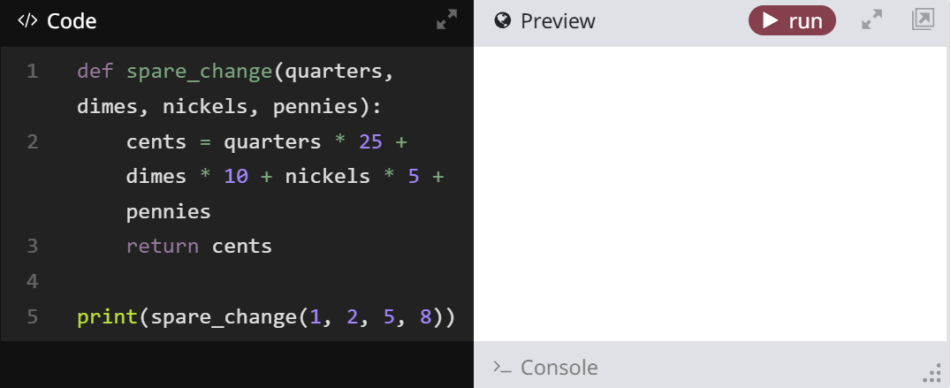
Parameters allow external information to be passed into functions. This allows for greater control and flexibility in your programs.
To use parameters, you add parameters into the function definition. You can define one or several parameters for your custom function to take. Give your parameters unique names and separate them with commas. You can then refer to them in your function body. In the example below, we pass the parameters to print().
def function_name(parameter1, parameter2, parameter3):
print(parameter1)
print(parameter2)
print(parameter3)
Here's an example of a function that takes the number of each type of coin you have (how many quarters, dimes, nickels, and pennies you have) and returns how much money the coins add up to.

Slide 4
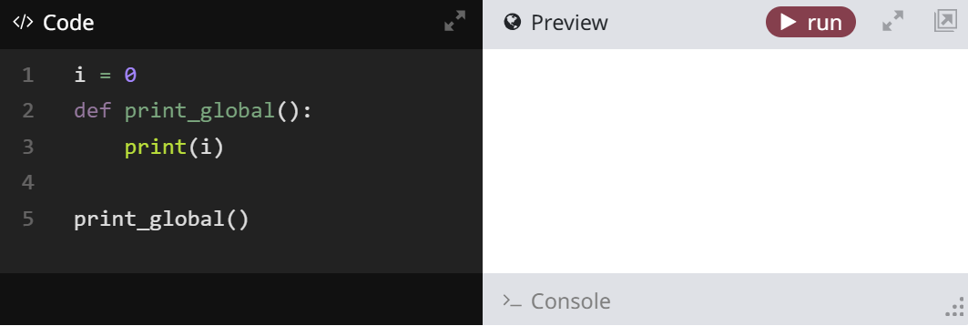
Function Scope
Now that you've seen the basics on creating a function, let's explore a concept called scope. Scope defines the visibility of an identifier (like a function or variable) within a section of code.
Within your functions, you can use any code you like, including all the concepts you've learned about so far, including variables, conditionals, and so on. But you'll want to understand how scope works, as it can create unexpected errors when you're writing your own functions.
Global Scope
Identifiers defined in global scope can be seen by all of the program. All identifiers defined outside of functions are in the global scope.
Since i is in global scope, the function print_global() can see and read from it.
However, if you need to change the variable i, you must tell the function that it is global.

Slide 5
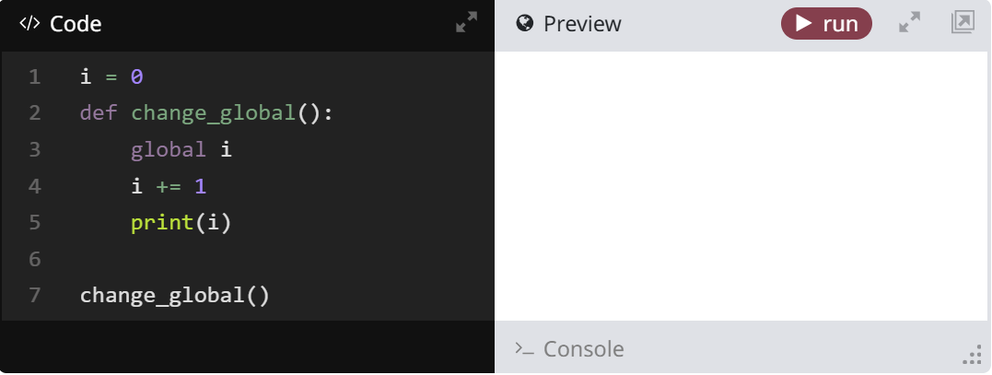
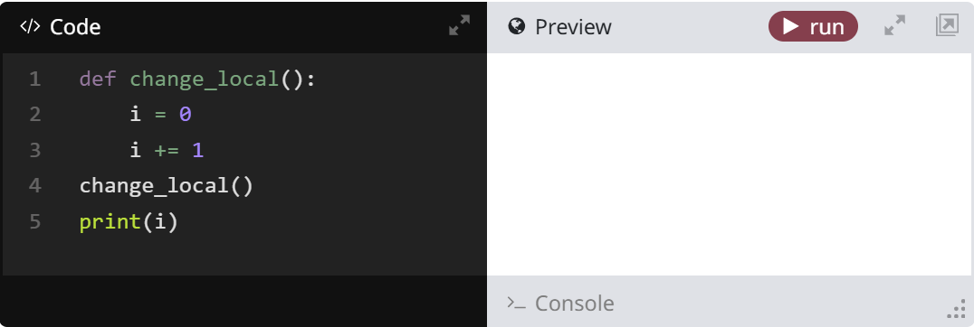
This is done using the global keyword.
Local Scope
Identifiers defined inside functions are in local scope and can only be seen by other code of the same scope, that is, code in the same function body.
If you run this code, you'll see that the code gives an error. This is because i is only defined in local scope and can't be seen outside the change_local() function.

Slide 6
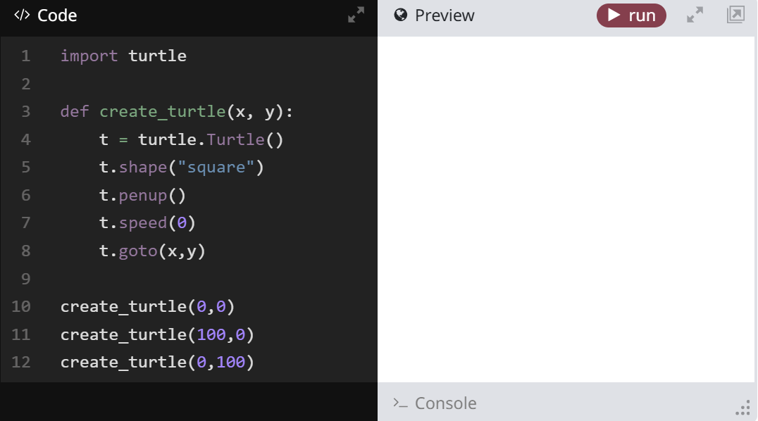
Click on the run button to try it out.

Slide 7
Responding to Key Presses
If we want to make games, we need a way to detect and respond to key presses in your programs so that the player can control the game.
The turtle module has a few built-in ways to detect key presses. We'll create functions that respond to user input in this section.
The onkey() Method
We'll use onkey() to add interactivity into our Turtle projects.
onkey() has two parameters.
The first parameter is the function you want to run in response to a key press
The second is the name of the key to want to bind the function to. You can use keys like "a" or "w". Or you can use "Up" and "Down" and so forth for the arrow keys.
It looks like this:
screen.onkey(func_name, "key")
For example, you might define a function called jump(), then bind the Space key to that function. You'd write that like this:
screen.onkey(jump, "Space")
Listen for Keys
Once you've used onkey(), we have to add another line of code to activate the turtle screen's listener. Otherwise, the screen won't "hear" the keys being pressed. You use it like this:
screen.listen()

Slide 8
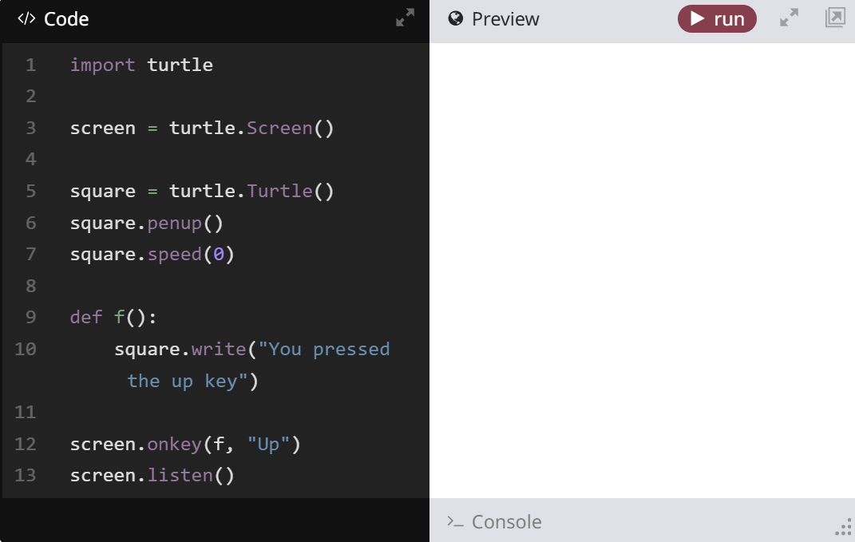
Notice that the listen() method does not require a parameter, and you only need to call it once to activate a turtle screen's listener, even if you have more than one onkey() method.
Detecting a Key Press
The example below defines a function called f and its task is to write "You pressed the up key" to the screen. We use a new Turtle method called write() to write text using Turtle graphics.
The first 8 lines of the code set up the turtle module, screen and turtle. Then we define the f() function at line 9.
Notice the last two lines of code, how we use the onkey() method. It takes f as a parameter, then "Up" as its second parameter, which is the name of the key we want to detect. Finally, we use listen() to make sure the screen will respond.
Click on the run button, then press the up arrow key to try it out.

Slide 9
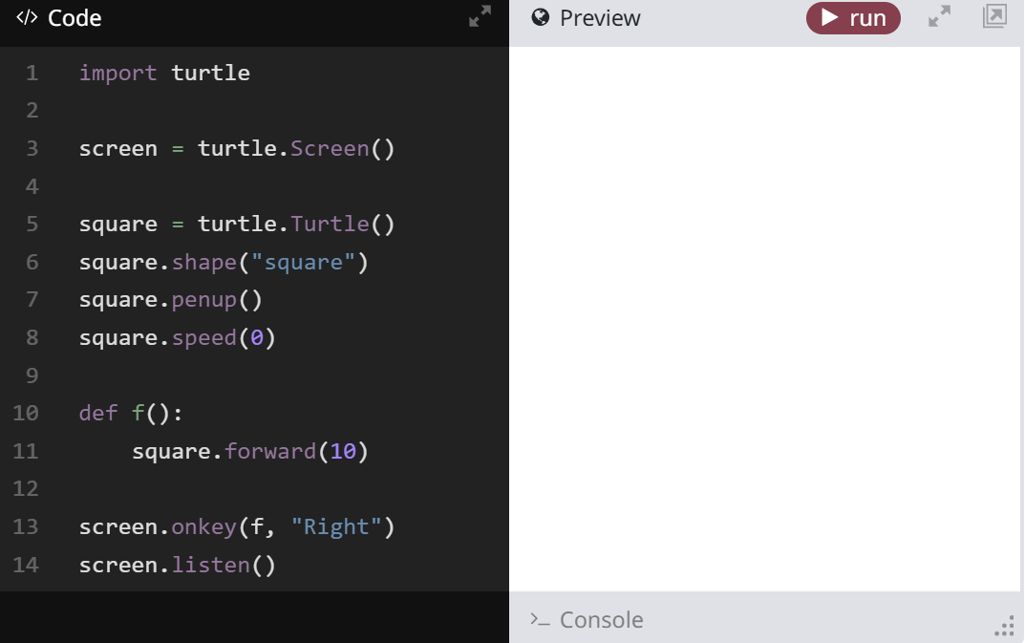
A Turtle That Moves
Let's try to make the turtle respond to a key press.
In this example, we will make a turtle move forward using the right arrow key. Click on the run button, then press the right arrow key to try it out.

Slide 10
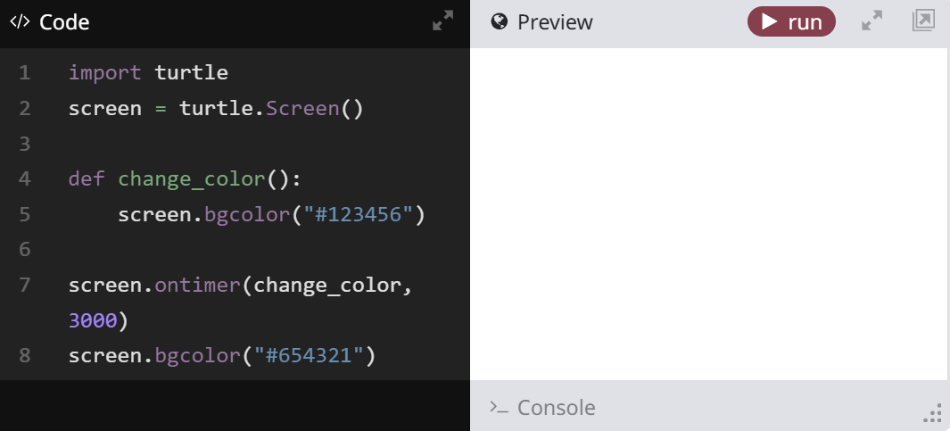
Adding a Delay with Timers
You can call code after a delay by using a timer. We can use this feature to control how our game behaves.
For example, we might want the player's sprite to appear right away, but power-ups and bad guys to only show up on the screen after a delay. We'll also use the timer to control how quickly our game runs.
The turtle screen has a method called ontimer() that allows code to be called after a delay.
ontimer() takes two parameters.
The first parameter is function you want to perform
The second is the time (in milliseconds) before the function will be called. A value of 1000 is equal to a delay of 1 second.
The ontimer() method also requires that the screen object's listener be activated, so you need to call the listen() method at the end of your code.
Delaying a Function Call
The example below defines a function called change_color(). Its task is to change the screen color after 3 seconds.

Slide 11
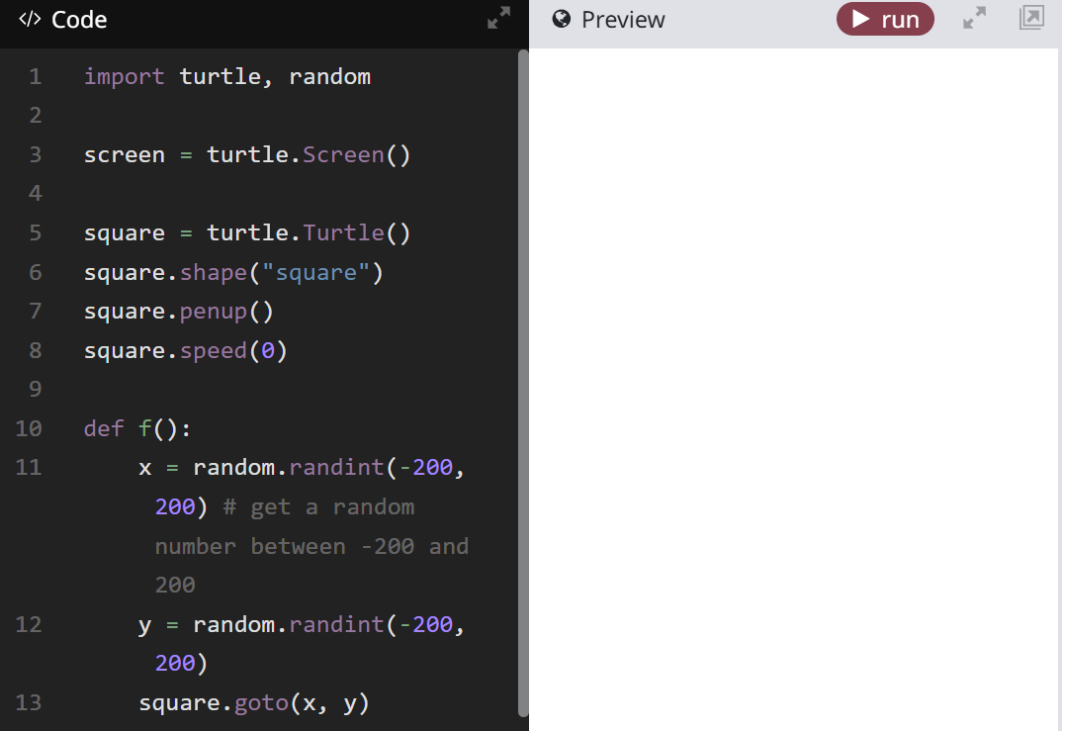
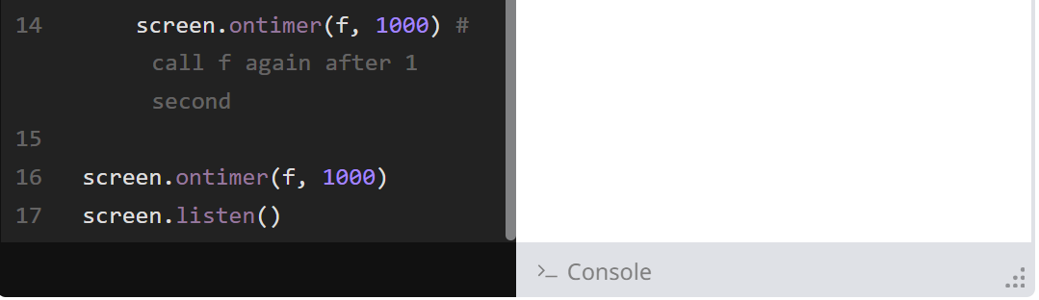
More on Timers
Let's try a more complicated use of the ontimer() function. In this example, we are going to make the square turtle teleport to a random location of the screen every second.
First we need to know little about the random module. This module has a function called randint() that returns a random number. The number randint() returns depends on its two parameters.
The first parameter is the lower limit of the random number. This number is included in the possible range of values.
The second parameter is the upper limit of the random number. Unlike similar functions like range() which exclude the upper limit, this number is also included in the possible range of values!

Slide 12
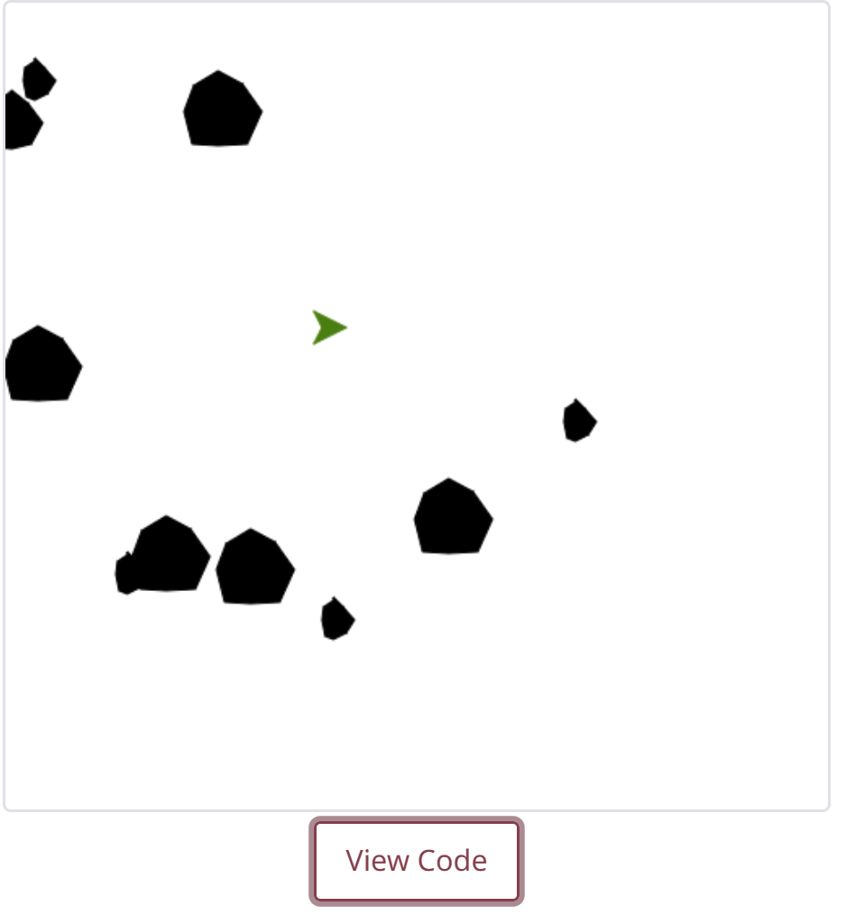
Asteroids
In this lesson you will learn how to code the user interaction for a simple game: Asteroids. When you are done, you will add some additional features.
Asteroid Example
Instructions
Launch the built-in Code Editor and follow the tutorial to make the simple game.
Remember to save your progress so that you can work on it later. Access your work from here or from "My Projects" in your Tynker account.

Slide 13
Review
Review what you have learned so far in this lesson. Read carefully because there's a Quiz coming up next!
Defining a Function
Function definitions begin with the keyword def followed by a function name and parentheses, and then a colon.
The code segment within each function is indented.
A return command exits a function and can pass a value back to the caller.
Here is an example of a function definition:
def function_name():
# commands
return
Function Parameters
Functions can also be defined with parameters, which allow external information to be passed into functions.
Parameters are added within the parentheses of function definitions. Parameter names should be unique and separated with commas.
Here is an example of a function that takes three parameters and prints them out:
def function_name(parameter1, parameter2, parameter3):
print(parameter1)
print(parameter2)
print(parameter3)

Slide 14
Function Scope
A scope defines the visibility of an identifier (a variable or function). You only need to know two levels of scope: global and local.
Global Scope
Identifiers defined in global scope can be seen by all of the program. All identifiers defined outside of functions are in global scope.
Local Scope
Identifiers defined inside functions are in local scope and can only be seen by code of the same scope. A variable defined inside a function cannot be accessed outside of that function.
The onkey() Function
The turtle screen has a method called onkey() that allows you to program a function to respond to any key.
onkey() takes two parameters:
The first parameter is the function you want to perform in response to the key press.
The second parameter requires a string of the key name. Some examples of valid names are: "Space", "a", "w", or "Up".
The ontimer() Function
The turtle screen has a function called ontimer() that allows code to be called on a timer.
ontimer() takes two parameters:
The first parameter is the function you want to perform.
The second is the time (in milliseconds) the function will wait before executing. Since it takes milliseconds, you would need to put 1000 in order to wait one second.

Slide 15
The listen() Function
You must activate the turtle screen's listener by calling its listen() method. This is required in order for any of the onkey() or ontimer() methods to take effect.
The listen() method does not require a parameter.
listen() only needs to be called once to activate a turtle screen's listener.

Slide 16
Quiz
Take a quiz that tests your knowledge on everything you have learned in this chapter.
1. What is the keyword used to start a function definition?
function
def
create
abracadabra
2. What is the output of the following code?
i = 0
def inc():
i = i + 1
print(i)
inc()
1
0
Nothing, it will produce an error.
Undefined
3. Why does the following code not print anything?
i = "hello world"
def print_hello_world():
print(i)
The variable i does not contain the string 'hello world.'
The function has not been called.
You can not access a global variable inside a function.
It will print 'hello world.'

Slide 17
4. What goes into the first parameter of the onkey function?
a function's name
a string of the key
onkey does not take any parameters
a number
5. Why does the following code not print 'Hello' when the space bar is pressed?
def say():
print("Hello")
screen.onkey(say(), "Space")
screen.listen()
screen.listen is not a function
The first parameter of onkey shouldn't include parentheses
The second parameter does not take a string
'say' is a keyword
7. What is an advantage of using a function?
It makes the code more modular and more readable.
It makes you have less bugs.
It makes code run faster.
It has no advantages.
8. True or False: All user defined functions can't have parameters.
true
false

Slide 18
9. True or False: Function names must follow the same naming rules as variables.
true
false
10. What is wrong with the following code?
def set_i():
i = 10
set_i()
print(i)
The code is correct.
'set_i' is not a valid function name.
'i' must be a string to use print.
'i' is not defined in global scope.
11. How many seconds does it take for the screen to print out 'Hello' after the following code is executed?
def print_hello_world():
print("Hello")
screen.ontimer(print_hello_world, 500)
screen.listen()
50 seconds
500 seconds
5 seconds
.5 seconds

